Slide 1


Slide 2
GROUP MEMBERS:
Kashir Hasnain(FA18-BSE-064)
Nabeel Ahmed(FA18-BSE-030)
SUPERVISED BY:
Dr. Sadaf Yasmin
DEPARTMENT OF COMPUTER SCIENCE
COMSATS UNIVERSITY ISLAMABAD, ATOOCK CAMPUS

Slide 3
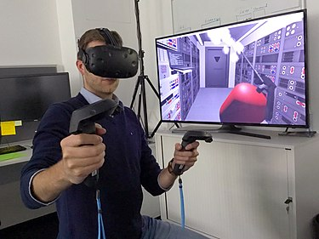
Learn cloud computing like a game
Virtual reality

Slide 4
Introduction of Virtual realityduction of augmented reality
Virtual Reality is basically the simulated experience that can be similar to or completely different from the real world.
It is commonly abbreviated as VR.
A person using virtual reality equipment can look around the artificial world, move around in it, and interact with virtual features or items. The effect is commonly created by VR headsets consisting of a head-mounted display with a small screen in front of the eyes but can also be created through specially designed rooms with multiple large screens. As the world is getting advanced in the field of technology day-by-day.
The world is discovering different creative ideas to learn about something.

Slide 5
Outline
Introduction
Problem statement
Solution
Objectives
Problems Faced During Game Testing in VR
System Architecture and Features
Activity diagram
UI
Tools and Technologies

Slide 6
Introduction
The Information and computer Technology (ICT) incorporate almost all aspects of life, including education and all other learning process.
The current method of learning about Cloud Computing are from different academies, YouTube, textbooks which shows only the detailed and too much explanation that poses difficulties for students in learning.
To address such problems, this project proposes the use of 3D Simulation and Virtual Reality(VR) to aid in learning about all the Cloud Computing.
This type of learning can help Students use both text media and 3D models, thus helping them gain a better understanding in learning Cloud Computing Technology.

Slide 7
Problem statement
Although there are no application which will convert the concepts into the models.
Mostly the new students' troubles while going to academies for learning and face difficulties to get reaching in academies.
Time consuming ,need a lot of time to go and attend the classes or Videos.
Inability to keep attention during the classes or Videos.
Some person which wants to learn Cloud Computing, this game help the student to clear the concepts.
Solution:
we are providing a single platform which allows students to understand complete steps of Cloud Computing using Virtual Reality.

Slide 8
Objectives
To teach all the Concepts of Cloud Computing (Private Cloud).
Learn all the concepts of Cloud Computing using Virtual Reality.
Lessons(Model Simulation with English narration) and quiz will be created in this project.

Slide 9
Problems in game testing vr
immersive environment
45 minutes Build Time or taking a small game testing up to 1 week
Camera Fixing Problems
Game Developed and Tested but Updating to VR creates problem

Slide 10
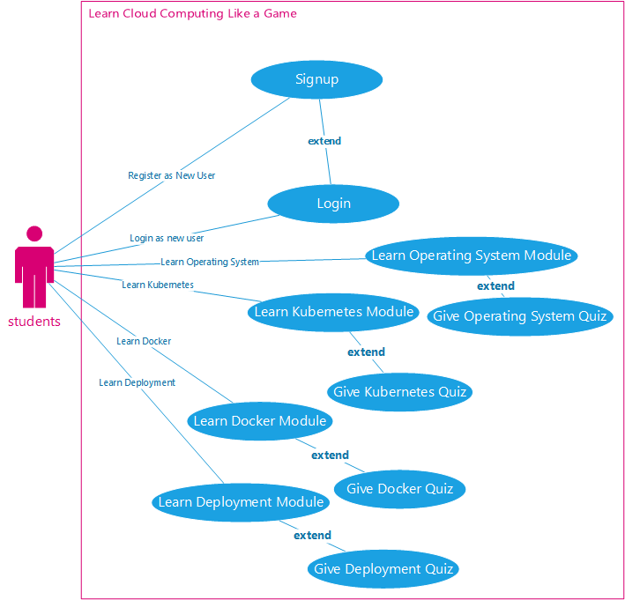
System Architecture and features

Slide 11
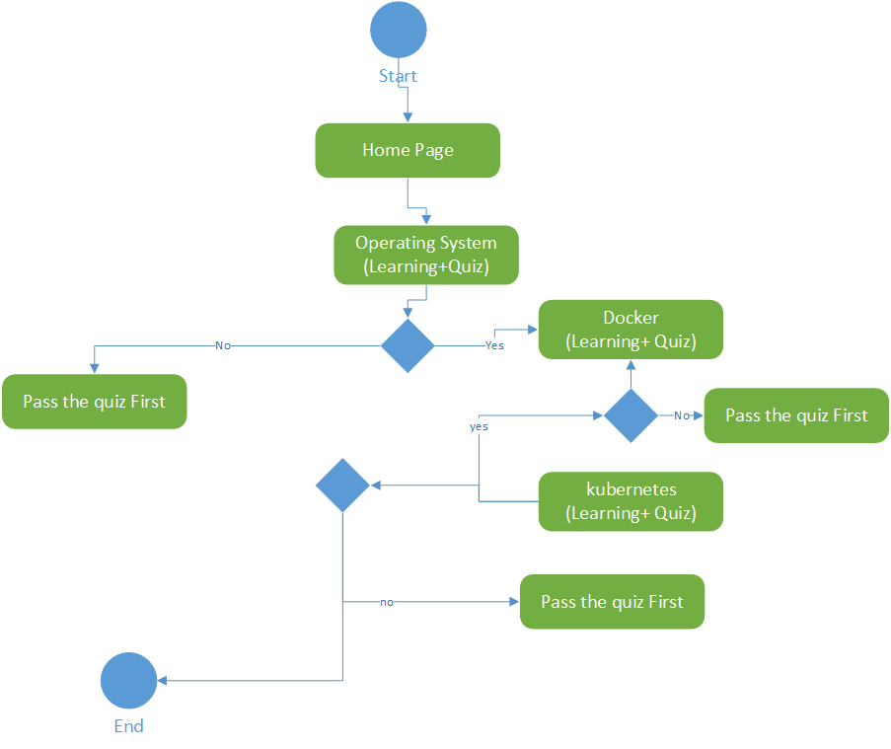
Activity diagram

Slide 12
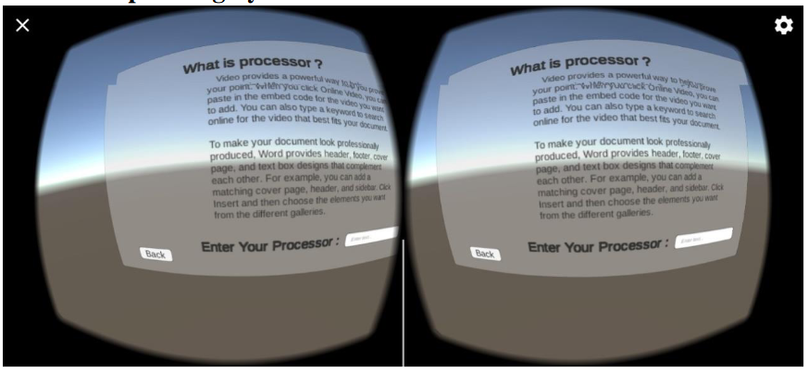
UI
Operating System UI

Slide 13
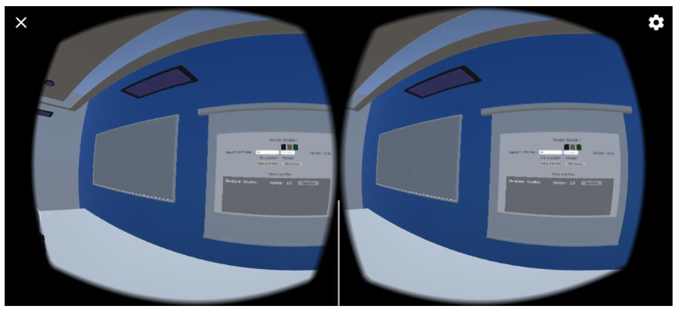
UI
Docker UI

Slide 14
Tools and Technologies
Unity (For Developing)
Visual Studio (For C#)
Blender (For Modeling and Designing)
Adobe Photoshop (For Button Design)
Adobe Photoshop (For Design UI)

